Slide 1
Young People Not Investing
What’s the Deal?

Slide 2
Do you plan on investing in the stock market when you are in your early 20s? Why or why not?

Slide 3
Millenials Slow to Start Investing in the Stock Market DOC
Based on this survey, what percentage of 18-25 year olds are investing in the stock market?
What are four of the reasons that explain why they aren’t investing? Circle the reason that you can relate to most.

Slide 4
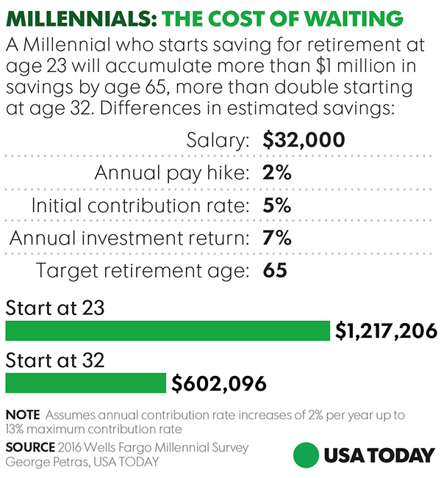
Millenials: The Cost of Waiting
Your friend says “Why invest now? That’s something for older people to worry about.” Using data from the chart, make a persuasive argument to change his mind.
The chart assumes a 7% annual investment return. Given what you know about interest on savings accounts and the returns for stock market investments, how do you think you would need to invest to earn that 7% return?

Slide 5
The Stock Markets Positive Returns:
1871 - 2014
Another reason that young investors opt not to invest is due to the “riskiness” of the stock market. This chart looks at over a hundred years of stock market history and breaks it up into various time intervals to assess risk. Use the chart to answer these questions:
Assuming you had a 15 year time horizon (held your investment for that period of time), how many times would you have lost money? What would have been your worst annual return?
Based on this historical data, what can you say about the relationship between the risk (of losing money) in the stock market and the length of time you hold an investment?
You have been asked by a friend how they should think about investing in the stock market. Convince them of the merits of long-term investing using the data above.

Slide 6
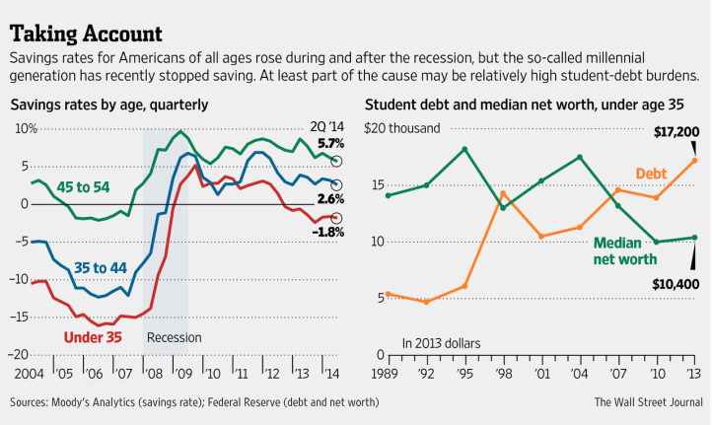
Taking Account of Savings Rates
Analyze these charts to find out why young people are saving less. Use your analysis to answer these questions:
Which age group had the lowest savings rate in 2014?
What has been the recent trend with student debt for those under the age of 35?
Do you think there is a relationship between student debt and savings rate? What might be other factors to consider as to why young people save less than other age groups?
Notes:
Teacher Tip: These charts demonstrate how our financial lives should be looked at holistically. Having a large student debt balance can crimp your lifestyle and also prevent you from saving for retirement at the most advantageous time.

Slide 7
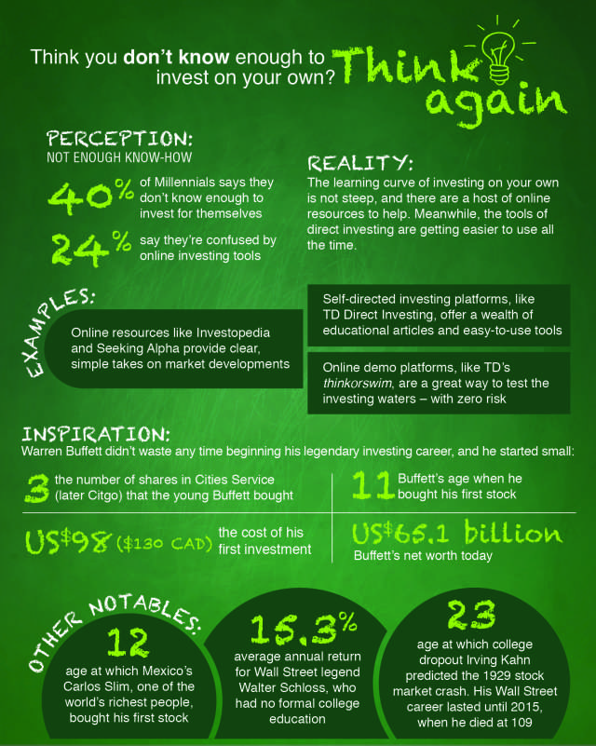
Think You Don’t Know Enough to Invest on Your Own?

Slide 8
Think You Don’t Know Enough to Invest on Your Own?
Another reason young investors shy away from jumping into the investing arena is the fear that they don’t know enough. Review this infographic for answers on how you can get started. After reviewing, answer the following questions:
Do you feel that you know enough to be an investor?
What can you learn from Warren Buffett’s first investment that can help you start investing?

